Slide 1





Mystic Squares

Slide 2
Introduction
Working Principle
Language
Description
Tools used
Specifications
Source Code
Possible Modifications
Output Display
Summary
Content of Work

Slide 3

Mystic Squares
The 15 puzzle (also called Gem Puzzle, Boss Puzzle, Game of Fifteen, Mystic Square and many others) is a sliding puzzle having 15 square tiles numbered 1–15 in a frame that is 4 tiles high and 4 tiles wide, leaving one unoccupied tile position. Tiles in the same row or column of the open position can be moved by sliding them horizontally or vertically, respectively. The goal of the puzzle is to place the tiles in numerical order.
Named for the number of tiles in the frame, the 15 puzzle may also be called a 16 puzzle, alluding to its total tile capacity. Similar names are used for different sized variants of the 15 puzzle, such as the 8 puzzle that has 8 tiles in a 3×3 frame.

Slide 4


Working Principle
The invariant is the parity of the permutation of all 16 squares plus the parity of the taxicab distance (number of rows plus number of columns) of the empty square from the lower right corner. This is an invariant because each move changes both the parity of the permutation and the parity of the taxicab distance. In particular, if the empty square is in the lower right corner then the puzzle is solvable if and only if the permutation of the remaining pieces is even.For larger versions of the n puzzle, finding a solution is easy, but the problem of finding the shortest solution is NP-hard. It is also NP-hard to approximate the fewest slides within an additive constant, but there is a polynomial-time constant-factor approximation. For the 15 puzzle, lengths of optimal solutions range from 0 to 80 single-tile moves (there are 17 configurations requiring 80 moves) or 43 multi-tile moves ; the 8 puzzle always can be solved in no more than 31 single-tile moves or 24 multi-tile moves . The multi-tile metric counts subsequent moves of the empty tile in the same direction as one.The number of possible positions of the 24 puzzle is 25!/2≈ 7.76×1024 which is too many to calculate God's number.

Slide 5

J
A
V
A

Slide 6

Language
Java was originally developed by James Gosling at Sun Microsystems. It was released in May 1995 as a core component of Sun Microsystems' Java platform.
Java is a high-level, class-based, object-oriented programming language that is designed to have as few implementation dependencies as possible.
The syntax of Java is similar to C and C++, but has fewer low-level facilities than either of them. The Java runtime provides dynamic capabilities (such as reflection and runtime code modification) that are typically not available in traditional compiled languages
As of 2019, Java was one of the most popular programming languages in use according to GitHub, particularly for client–server web applications, with a reported 9 million developers.

Slide 7




Tools Used
Swing is a set of program component s for Java programmers that provide the ability to create graphical user interface (GUI ) components, such as buttons and scroll bars,that are independent of the windowing system for specific operating system. Swing components are used with the Java Foundation.
The javax.swing.JFrame class is a type of container which inherits the java.awt.Frame class. Frameworks like the main window where components like labels, buttons, text fields are added to create a GUI. Unlike Frame, Frame has the option to hide or close the window with the help of setDefaultCloseOperation(int).
Java AWT is an API that contains large number of classes and methods to create and manage graphical user interface ( GUI ) applications. The AWT was designed to provide a common set of tools for GUI design that could work on a variety of platforms.
JPanel, a part of the Java Swing package, is a container that can store a group of components. The main task of JPanel is to organize components, various layouts can be set in JPanel which provide better organization of components, however, it does not have a title bar.

Slide 8






Description
We need to define a reset method used to initialize the GameofFifteen instance. In that method, we set a value to each element of the tiles array. At the end of the method, we set the blankPos at the last position of the array. We need also a shuffle method for shuffling the tiles array. We don’t include the blank tile in the shuffling process to leave it in the solved position. To make sure our Game of Fifteen instance is solvable, we define a isSolvable method. Most important thing to consider is that only half permutations of the puzzle are solvable. Whenever a tile is preceded by a tile with higher value it counts as an inversion. In our case, with the blank tile in the solved position, the number of inversions must be even for the puzzle to be solvable. So, we count the number of inversions and we return true if the number is even. Then, it is essential to define a isSolved method to check if our Game Of Fifteen instance is solved. First, we check if the blank tile is in the solved position. If so, the instance of the game is not solved. Then, we iterate on the tiles in reverse order and if a tile value is different from the corresponding index + 1, we return false. Otherwise, at the end of the method, we can return true because our Game of Fifteen instance is solved. We need also to define a newGame method to create a new instance of the game. For that we reset the board, then we shuffle it and we continue until the game instance be solvable.

Slide 9
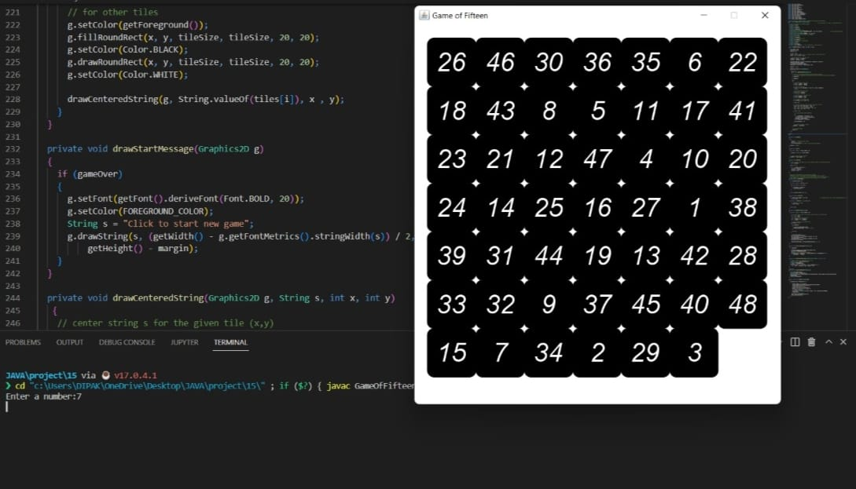
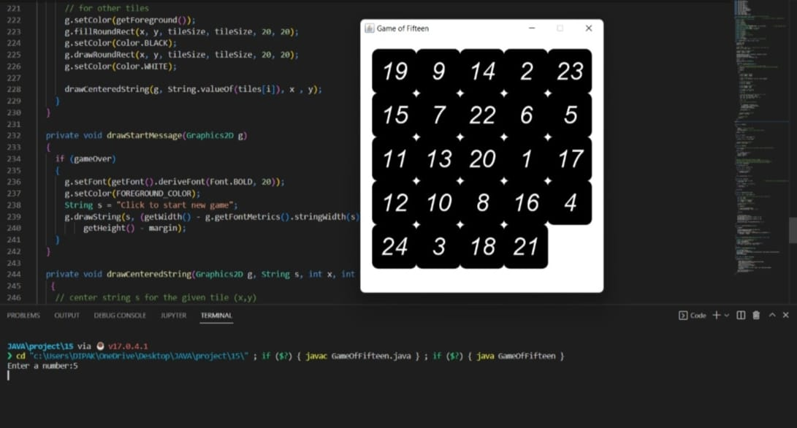
Specifications:
With the help of users input we can change the number of dimensions and number of grids of the game to increase its complexity and difficulty.

Slide 10

SOURCE CODE
import java.util.Scanner;
import java.awt.BorderLayout;
import java.awt.Color;
import java.awt.Dimension;
import java.awt.Font;
import java.awt.FontMetrics;
import java.awt.Graphics;
import java.awt.Graphics2D;
import java.awt.RenderingHints;
import java.awt.event.MouseAdapter;
import java.awt.event.MouseEvent;
import java.util.Random;
import javax.swing.JFrame;
import javax.swing.JPanel;
import javax.swing.SwingUtilities;
// We are going to create a Game of 15 Puzzle with Java and Java Swing
public class GameOfFifteen extends JPanel
{ // our grid will be drawn in a dedicated Panel
// Size of our Game of Fifteen instance
private int size;
// Number of tiles
private int nbTiles;
// Grid UI Dimension
private int dimension;

Slide 11
// Foreground Color102,0,153
private static final Color FOREGROUND_COLOR = new Color(0,0,0); // we use arbitrary color
// Random object to shuffle tiles
private static final Random RANDOM = new Random();
// Storing the tiles in a 1D Array of integers
private int[] tiles;
// Size of tile on UI
private int tileSize;
// Position of the blank tile
private int blankPos;
// Margin for the grid on the frame
private int margin;
// Grid UI Size
private int gridSize;
private boolean gameOver; // true if game over, false otherwise
public GameOfFifteen(int size, int dim, int mar)
{
this.size = size;
dimension = dim;
margin = mar;
// init tiles
nbTiles = size * size - 1; // -1 because we don't count blank tile
tiles = new int[size * size];
// calculate grid size and tile size
gridSize = (dim - 2 * margin);
tileSize = gridSize / size;

Slide 12
setPreferredSize(new Dimension(dimension, dimension + margin));
setBackground(Color.WHITE);
setForeground(FOREGROUND_COLOR);
setFont(new Font("Arial", Font.ITALIC, 40));
gameOver = true;
addMouseListener(new MouseAdapter()
{
@Override
public void mousePressed(MouseEvent e)
{
// used to let users to interact on the grid by clicking
// it's time to implement interaction with users to move tiles to solve the game !
if (gameOver)
{
newGame();
}
else
{
// get position of the click
int ex = e.getX() - margin;
int ey = e.getY() - margin;
// click in the grid ?
if (ex < 0 || ex > gridSize || ey < 0 || ey > gridSize)
return;

Slide 13
// get position in the grid
int c1 = ex / tileSize;
int r1 = ey / tileSize;
// get position of the blank cell
int c2 = blankPos % size;
int r2 = blankPos / size;
// we convert in the 1D coord
int clickPos = r1 * size + c1;
int dir = 0;
// we search direction for multiple tile moves at once
if (c1 == c2 && Math.abs(r1 - r2) > 0)
dir = (r1 - r2) > 0 ? size : -size;
else if (r1 == r2 && Math.abs(c1 - c2) > 0)
dir = (c1 - c2) > 0 ? 1 : -1;
if (dir != 0)
{
// we move tiles in the direction
do
{
int newBlankPos = blankPos + dir;
tiles[blankPos] = tiles[newBlankPos];
blankPos = newBlankPos;
} while(blankPos != clickPos);

Slide 14
tiles[blankPos] = 0;
}
// we check if game is solved
gameOver = isSolved();
}
// we repaint panel
repaint();
}
});
newGame();
}
private void newGame()
{
do
{
reset(); // reset in intial state
shuffle(); // shuffle
} while(!isSolvable()); // make it until grid be solvable
gameOver = false;
}
private void reset()
{
for (int i = 0; i < tiles.length; i++)

Slide 15
{
tiles[i] = (i + 1) % tiles.length;
}
// we set blank cell at the last
blankPos = tiles.length - 1;
}
private void shuffle()
{
// don't include the blank tile in the shuffle, leave in the solved position
int n = nbTiles;
while (n > 1)
{
int r = RANDOM.nextInt(n--);
int tmp = tiles[r];
tiles[r] = tiles[n];
tiles[n] = tmp;
}
}
// Only half permutations o the puzzle are solvable
// Whenever a tile is preceded by a tile with higher value it counts
// as an inversion. In our case, with the blank tile in the solved position,
// the number of inversions must be even for the puzzle to be solvable

Slide 16
private boolean isSolvable()
{
int countInversions = 0;
for (int i = 0; i < nbTiles; i++)
{
for (int j = 0; j < i; j++)
{
if (tiles[j] > tiles[i])
countInversions++;
}
}
return countInversions % 2 == 0;
}
private boolean isSolved()
{
if (tiles[tiles.length - 1] != 0) // if blank tile is not in the solved position ==> not solved
return false;
for (int i = nbTiles - 1; i >= 0; i--)
{
if (tiles[i] != i + 1)
return false;
}
return true;
}

Slide 17
private void drawGrid(Graphics2D g)
{
for (int i = 0; i < tiles.length; i++)
{
// we convert 1D coords to 2D coords given the size of the 2D Array
int r = i / size;
int c = i % size;
// we convert in coords on the UI
int x = margin + c * tileSize;
int y = margin + r * tileSize;
// check special case for blank tile
if(tiles[i] == 0)
{
if (gameOver)
{
g.setColor(FOREGROUND_COLOR);
drawCenteredString(g, "\u2713", x, y);
}
continue;
}
// for other tiles
g.setColor(getForeground());
g.fillRoundRect(x, y, tileSize, tileSize, 20, 20);
g.setColor(Color.BLACK);
g.drawRoundRect(x, y, tileSize, tileSize, 20, 20);
g.setColor(Color.WHITE);

Slide 18
drawCenteredString(g, String.valueOf(tiles[i]), x , y);
}
}
private void drawStartMessage(Graphics2D g)
{
if (gameOver)
{
g.setFont(getFont().deriveFont(Font.BOLD, 20));
g.setColor(FOREGROUND_COLOR);
String s = "Click to start new game";
g.drawString(s, (getWidth() - g.getFontMetrics().stringWidth(s)) / 2,
getHeight() - margin);
}
}
private void drawCenteredString(Graphics2D g, String s, int x, int y)
{
// center string s for the given tile (x,y)
FontMetrics fm = g.getFontMetrics();
int asc = fm.getAscent();
int desc = fm.getDescent();
g.drawString(s, x + (tileSize - fm.stringWidth(s)) / 2,
y + (asc + (tileSize - (asc + desc)) / 2));
}

Slide 19
@Override
protected void paintComponent(Graphics g)
{
super.paintComponent(g);
Graphics2D g2D = (Graphics2D) g;
g2D.setRenderingHint(RenderingHints.KEY_ANTIALIASING, RenderingHints.VALUE_ANTIALIAS_ON);
drawGrid(g2D);
drawStartMessage(g2D);
}
public static void main(String[] args)
{
SwingUtilities.invokeLater(() ->
{
JFrame frame = new JFrame();
frame.setDefaultCloseOperation(JFrame.EXIT_ON_CLOSE);
frame.setTitle("Game of Fifteen");
frame.setResizable(false);
Scanner sc=new Scanner(System.in);
System.out.print("Enter a number:");
int num=sc.nextInt();
frame.add(new GameOfFifteen(num, num*80 , 20), BorderLayout.CENTER);
frame.pack();
// center on the screen
frame.setLocationRelativeTo(null);
frame.setVisible(true);
});
}
}

Slide 20



“Chess World Champion Bobby Fischer was an expert at solving the puzzle , in 15 seconds.”

Slide 21



POSSIBLE MODIFICATIONS
From this small platform we can bring to large platform by using more flexible ways.
We can bring this to an online platform, connecting people from different places and can implement more functions like multiple players, stopwatch and weekly targets.
We can convert this source code to a proper application using various platforms.

Slide 22
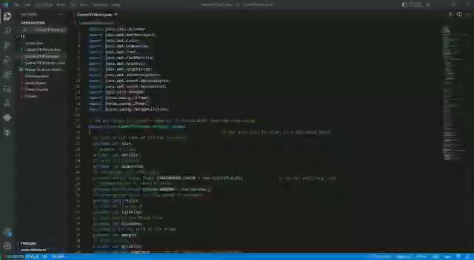
OUTPUT:

Slide 23
Summary
So, basically The 15 Puzzle, also called Game of Fifteen, is a sliding puzzle that consists of a frame of numbered square tiles in random order with one tile missing. To solve the puzzle, the players must place the tiles in order by making sliding moves that use the empty space.
Most important thing to consider is that only half permutations of the puzzle are solvable. Whenever a tile is preceded by a tile with higher value it counts as an inversion. In our case, with the blank tile in the solved position, the number of inversions must be even for the puzzle to be solvable. So, we count the number of inversions and we return true if the number is even.

Slide 24
LAPTOP SPECIFICATION
Device Name: DESKTOP-5G18G3I
Processor: AMD Ryzen 5 3450U with Radeon Vega Mobile Gfx 2.10 GHz
RAM: 8 GB
System Type: 64-bit operating system
OS: Windows 11 Home Single Language
Version: 21H2
Manufacturer: DELL

Slide 25




CREDITS
CodeOPS
Dipak Agarwal,Dibya Shankar Jha, Debangkita Dutta, Debaditya Chanda, Ananta, Shrey Pratap Singh, Ananya Sengupta
References :
https://en.wikipedia.org/wiki/15_puzzle
https://ssaurel.medium.com/developing-a-15-puzzle-game-of-fifteen-in-java-dfe1359cc6e3
https://www.edureka.co/blog/what-is-java/

Slide 26



